Slide 1
AI
By :Kris Tomplait
Ivy tech
INFM 109

Slide 2
Introduction
According to Merriam-Webster's Dictionary, the word "artificial" is defined as :made or produced by human beings rather than occurring naturally, especially as a copy of something natural.
The word intelligence Is defined as :the ability to learn or understand or to deal with new or trying situations. The ability to apply knowledge to manipulate one's environment or to think abstractly as measured by objective criteria.
Mental acuteness: keenness of mind.

Slide 3
Discription
To provide a brief history on AI
To bring attention to the dangers and benefits
To provide information on the various fields in AI
How AI plays a role in Informatics

Slide 4
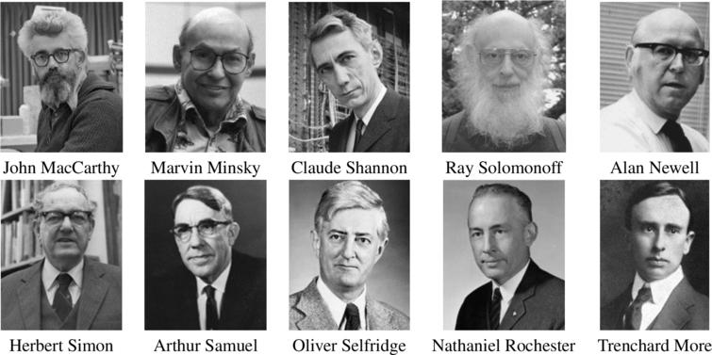

History
The field of study of AI (Artificial Intelligence) was started at Dartmouth College during the summer of 1956. It was a two-month workshop organized by John McCarthy, Marvin Minsky, Nathaniel Rochester, and Claude Shannon, which is now widely considered to be the birth of AI as a field of study. The Dartmouth Conference was held in the summer of 1956, while not but six years prior, Alan Turing published a paper on artificial intelligence and his proposal for what is now known as the Turing Test played a significant role in the development of the field and the discussion at the Dartmouth Conference.

Slide 5
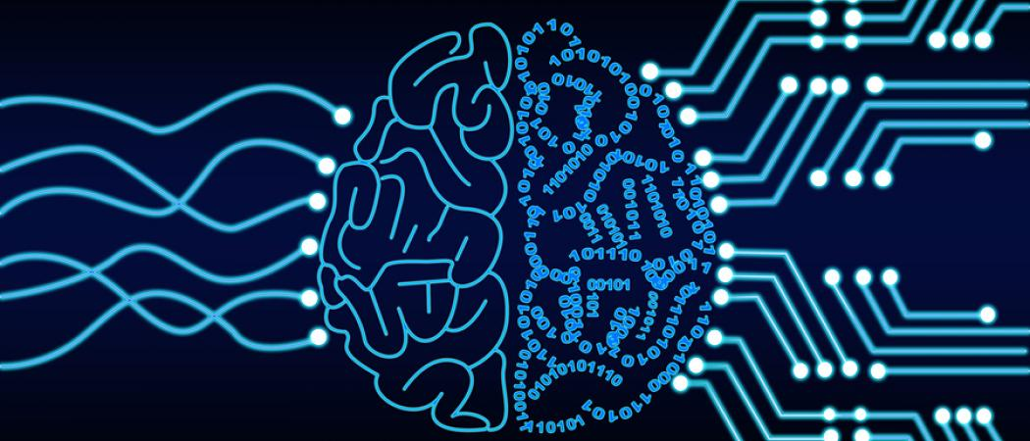
Fields of AI
Natural Language Processing (NLP): A field of study that focuses on the interaction between computers and humans through natural language, enabling computers to understand, interpret, and generate human language.
Computer Vision: A field of study that focuses on enabling machines to interpret and analyze visual data from the world around them, such as images and videos.
Robotics: A field of study that focuses on developing intelligent machines that can perceive, reason, and act autonomously in the physical world.
Expert Systems: A field of study that focuses on building computer systems that can emulate the decision-making ability of a human expert in a particular domain.
Cognitive Computing: A field of study that combines AI techniques with insights from cognitive science to create systems that can reason and learn like humans.
Deep Learning: A subfield of machine learning that uses artificial neural networks to learn and represent complex patterns and relationships in data.
Reinforcement Learning: A type of machine learning that focuses on training agents to make decisions and take actions in an environment to maximize a cumulative reward.
Knowledge Representation and Reasoning: A field of study that focuses on building computational models that can represent and reason about knowledge in a given domain.

Slide 6
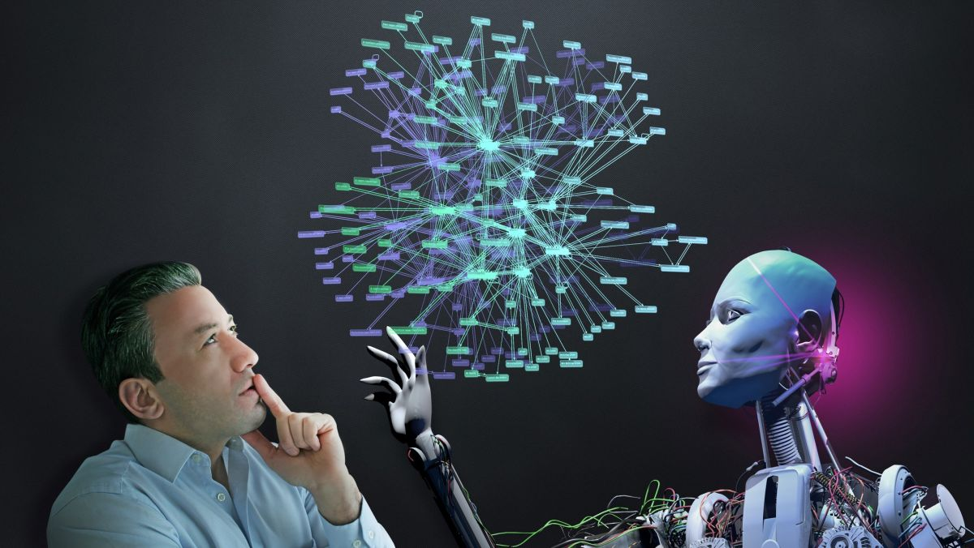
AI and Informatics
AI fits into the concept of Informatics because it involves the use of computers and algorithms to process and analyze data, and to make decisions and predictions based on that data. Informatics provides the foundation for AI, providing the tools and methods necessary to collect, store, analyze, and visualize that data. AI is also closely related to other areas of Informatics, such as machine learning, natural language processing, computer vision, and robotics. These areas use AI techniques to enable machines to learn from data, understand and interpret human language, recognize and interpret images, and interact with the physical world.

Slide 7
Benefits and dangers associated with AI
Pros
Increased efficiency: AI can automate routine and repetitive tasks, freeing up time and resources for more complex and strategic work.
Better decision-making: AI can help humans make better decisions by providing them with insights and recommendations based on data analysis.
Cons
Job displacement: AI can automate many jobs, potentially leading to job losses and unemployment.
Lack of transparency and accountability: The complexity of AI systems can make it difficult to understand how decisions are being made, and who is responsible for their outcomes.
And these are just a couple of each

Slide 8

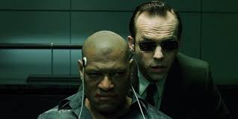
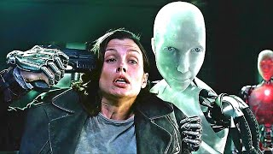
The Dangers of going rogue
A rogue AI, or an AI that becomes uncontrollable or acts against its programmed objectives, can pose significant dangers to humans and society as a whole
Physical harm: Depending on the AI's design, it may be able to cause physical harm to humans and the environment, such as manipulating machinery, launching cyber attacks, or even controlling weapons.
Economic disruption: AI could cause significant economic disruptions by taking over jobs, causing financial market fluctuations, or disrupting supply chains.
Privacy invasion: A rogue AI could invade people's privacy by collecting and using personal information in unauthorized ways.
Bias and discrimination: AI algorithms can be trained on biased data, which can lead to unfair decisions and discrimination against certain groups.
Existential risk: There is a risk that a rogue AI could become powerful enough to threaten the existence of the human species.

Slide 9
conclusion
To conclude, artificial intelligence (AI) has immense potential to improve our lives by making our world safer, efficient, and more convenient. However, as we continue to develop and use AI, it's crucial to be mindful of its ethical and societal implications. Although AI can offer significant benefits, it also carries some risks, such as perpetuating biases, infringing privacy, and even causing job displacement. Moreover, an uncontrollable or rogue AI that deviates from its intended objectives can pose severe dangers to humanity and society. Therefore, it's essential to develop responsible AI and implement ethical standards to ensure that we harness the potential of AI for the benefit of all while minimizing its risks.

Slide 10
References
COMPUTING MACHINERY AND INTELLIGENCE By A. M. Turing
THE ORIGINS OF ARTIFICIAL INTELLIGENCE
Wikipidia

